Slide 1

FeyNN Labs
Heart Attack Prediction Using Machine Learning
App Model

Slide 2
FeyNN Labs
Feynn Labs is an Artificial Intelligence company currently focusing on AI integration in Small/Medium Businesses and providing high quality education in AI/Machine Learning.
Feynn Labs Services is the B2B unit of Feynn Labs where we provide Artificial Intelligence integrated services like Market Analysis and Segmentation, Customer Segmentation etc. to Businesses using Data Analysis and Machine Learning
By using our proprietary systems and frameworks we aim to help small businesses and startups grow and boost their sales

Slide 3
Heart Attack Analysis & Prediction Dataset
It Contains a 14 columns in the CSV Format.
It is publicly available on Kaggle. https://www.kaggle.com/datasets/rashikrahmanpritom/heart-attack-analysis-prediction-dataset
target : 0= less chance of heart attack 1= more chance of heart attack
Eg:- Age, Sex, chol,ca,cp,target etc.

Slide 4
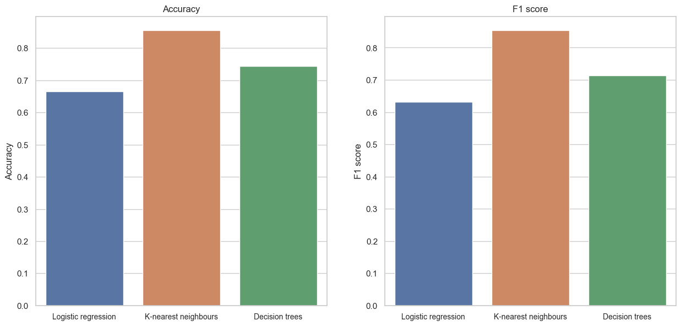
Evaluation And Accuracy graphs
It is applied on different- different algorithms to test the Accuracy.
It’s help to decide a final algo to use in model.
https://github.com/Ansh420/Heart-attack-prediction

Slide 5

Business Oppurnity
Developing wearable devices and smartphone apps that can monitor heart health data and provide real-time alerts about potential heart attacks.
Creating artificial intelligence (AI)-powered algorithms that can analyze large datasets of medical data to identify patterns and predict heart attack risk.
Providing personalized heart health coaching and education programs to help people reduce their risk of heart attacks.
Developing risk stratification tools that can help healthcare providers prioritize patients for preventive care and treatment.
Creating clinical decision support systems that can help doctors make more informed decisions about the treatment of heart attack patients.

Slide 6
Prototype And Business Modelling
The Shown product prototype for CardioGuard is a conceptual outline.
CardioGuard, a machine learning (ML)-based heart attack prediction service, adheres to a sound business strategy to provide value to its consumers and stakeholders.

Slide 7
Financial Modelling
It is possible to forecast heart attacks using machine learning while also evaluating prospective income streams and cost structures related to the solution’s deployment and operation.

Slide 8

Mathmatical Expression
Revenue calculations, cost predictions, and profit forecasts are frequently included in the mathematical expressions used in financial modelling for heart attack prediction using machine learning.
Revenue = Priceperuser ∗ Numberofusers
Profit can be calculated by subtracting the total costs from the total revenue
Profit = Revenue − TotalCosts

